Slide 1
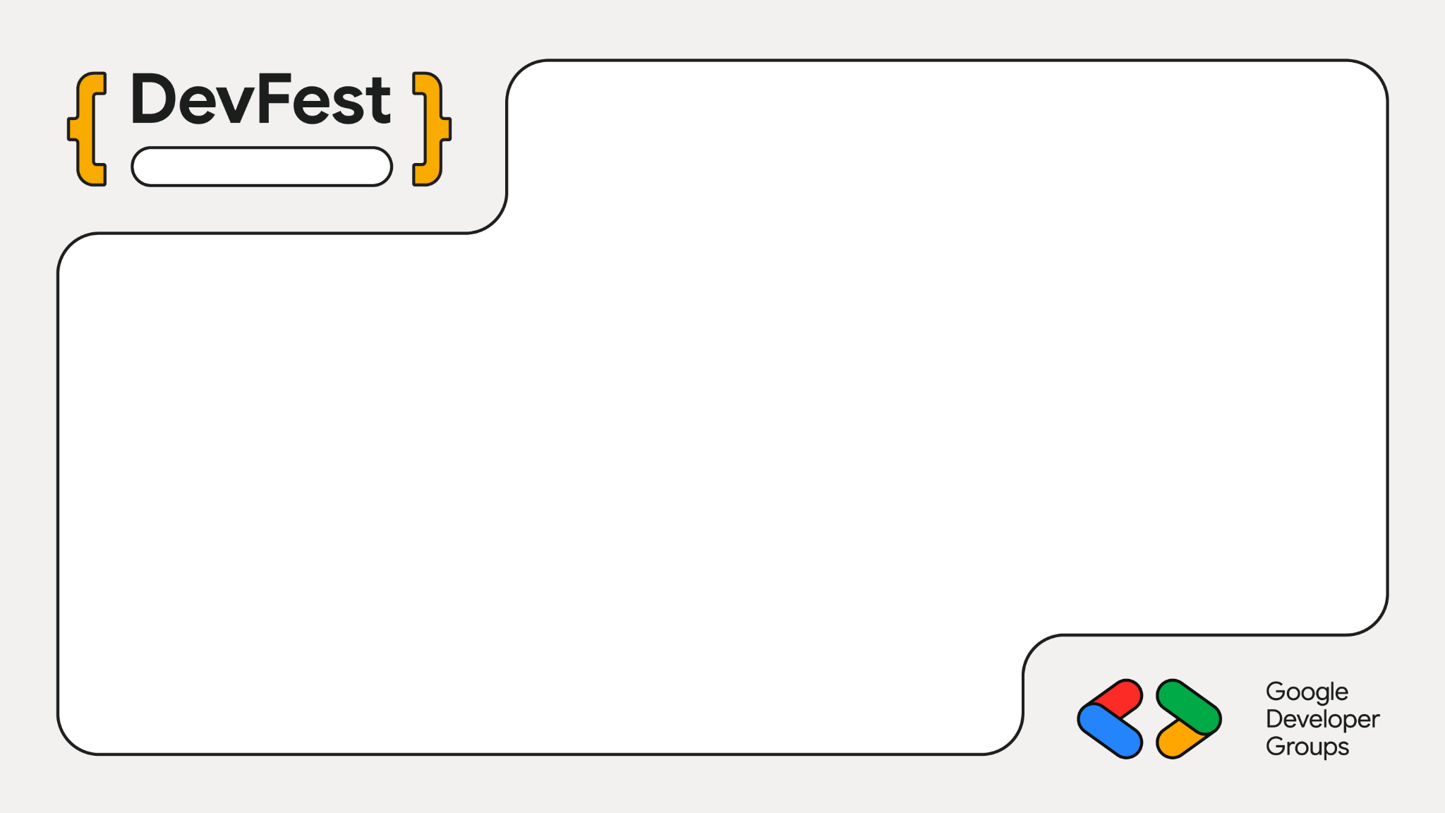
Chennai
From Cloud to Pocket: Refining Stories with Google’s Gemini API and Gemma On-Device Model
Mayur Madnani

Slide 2
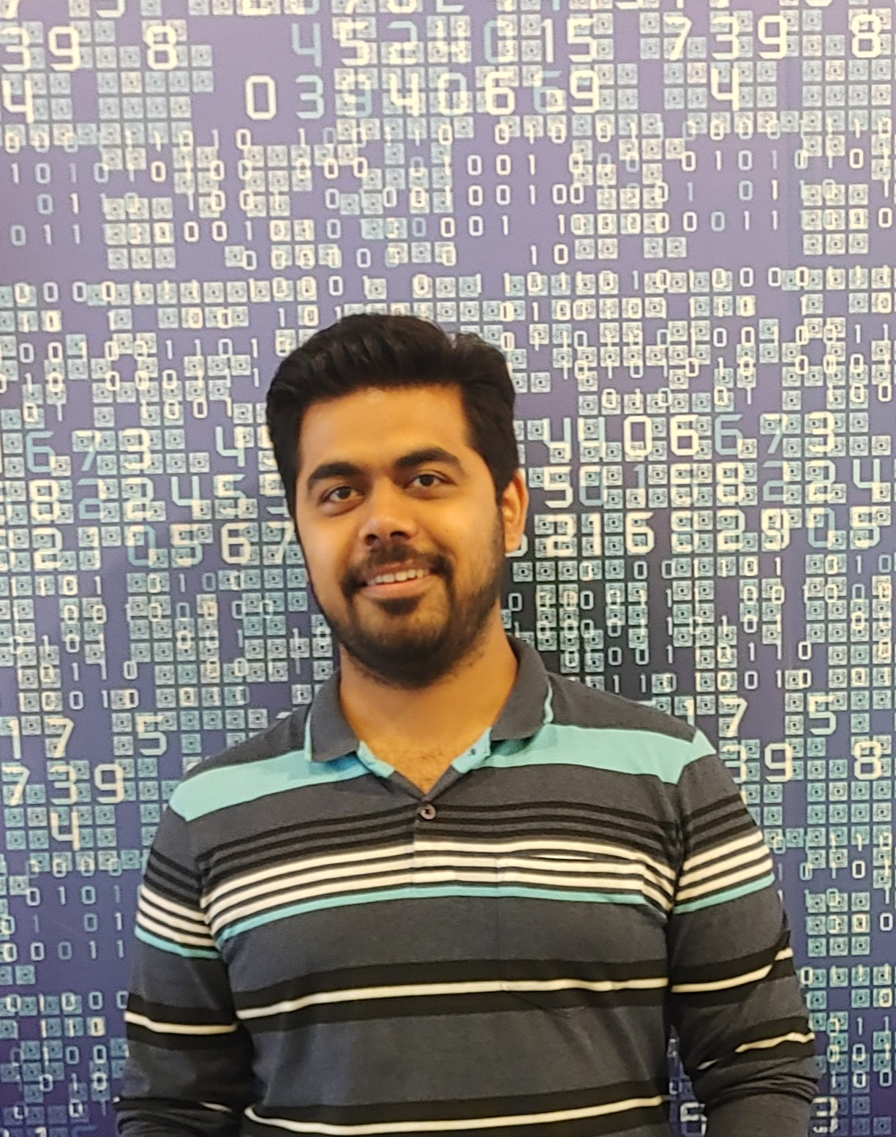
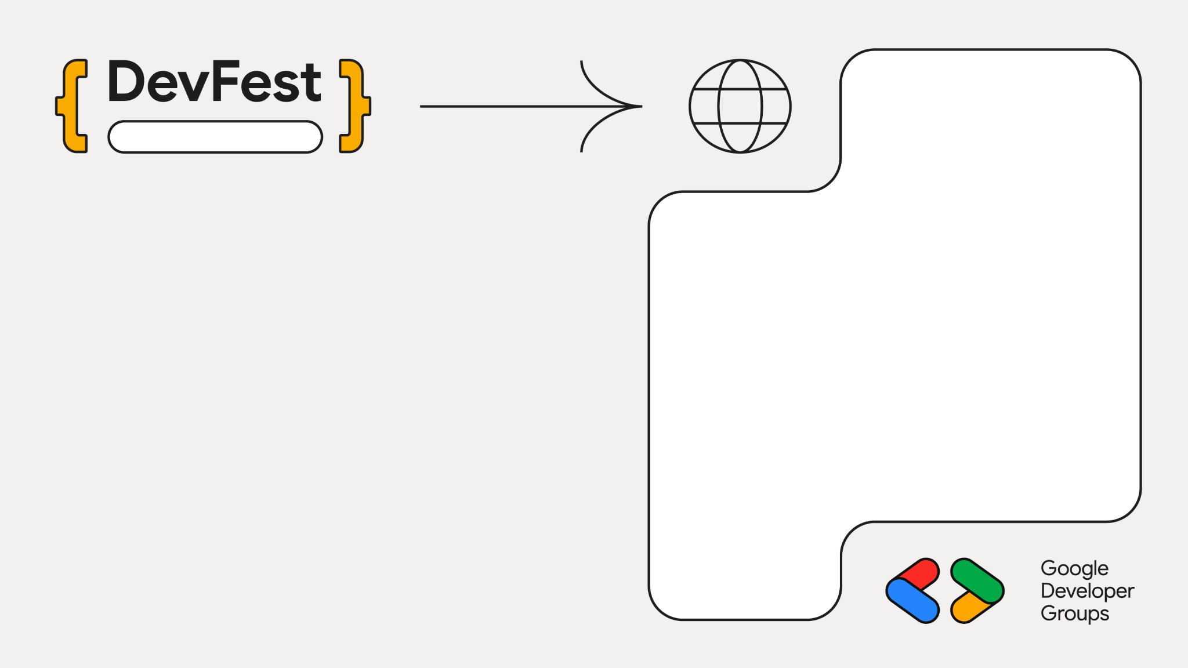
Chennai
Staff Engg @ JioHotstar
Previously @ Intuit, Walmart, SAP
Expertise in Data, AI and Backend
~10 years in the Industry
GenAI Course Author
Mentor
Speaker
Mayur Madnani

Slide 3
Language Models
LLMs
SLMs
Massive Scale
Knowledge Transfer
Deep Architecture
Compact
Architecture
Versatile Performance
Precision focused
Resource Intensive
Agentic & privacy focus

Slide 4









SLM Offerings

Slide 5
Gemma models Deeper Dive
Gemma is Google's family of open, lightweight models built from the same research powering Gemini—delivering enterprise-grade performance with efficiency.
Decoder-Only Transformer
Streamlined architecture for efficient text generation
Advanced Attention
Multi-Head/Multi-Query mechanisms for efficiency
Shared Embeddings
RoPE and GeGLU activations for position encoding
Vision-Language
Multimodal capability for processing text and visuals
MatFormer Innovation
Matryoshka Representation learning

Slide 6
Model Adaptation Imperative
Domain Mismatch
Generic models struggle in specialized fields—finance, healthcare, niche coding languages.
Static Knowledge
Pre-trained models lack evolving information and real-time context.
Deployment Constraints
Large model size makes industry deployment costly and impractical.

Slide 7
Adaptation Techniques
Parametric Knowledge Adaptation
Updates model's weights.
DAPT: Domain-Adaptive Pre-Training
SFT: Supervised Fine-Tuning
PEFT (LoRA): Parameter-Efficient Fine-Tuning
Ideal for: Efficient domain shift (healthcare chatbots, financial analysis)
Semi-Parametric Knowledge Adaptation
Leverage external knowledge sources.
RAG: Retrieval-Augmented Generation
Agent-Based Systems: Dynamic tool integration
Ideal for: Real-time knowledge integration (dynamic APIs, live data)

Slide 8
Prompt Engineering Strategies
Few-Shot Prompting
Provide targeted examples within the prompt to guide model behavior and task execution.
Chain-of-Thought (CoT)
Instruct models to "think step-by-step" for improved reasoning on complex, multi-stage problems.
Prompt engineering transforms model behavior without changing weights—maximizing value from pre-trained models through strategic input design

Slide 9
LoRA: Low-Rank Adaptation
Supervised Fine-Tuning (SFT)
Adapts pre-trained models to specialized tasks using labeled instruction-response pairs.
Freezes original model weights, injects small trainable low-rank matrices into transformer layers.
Extreme Efficiency
Fine-tune large models on consumer or single GPU.
Modular Portability
Maintain multiple lightweight LoRA adapters.

Slide 10
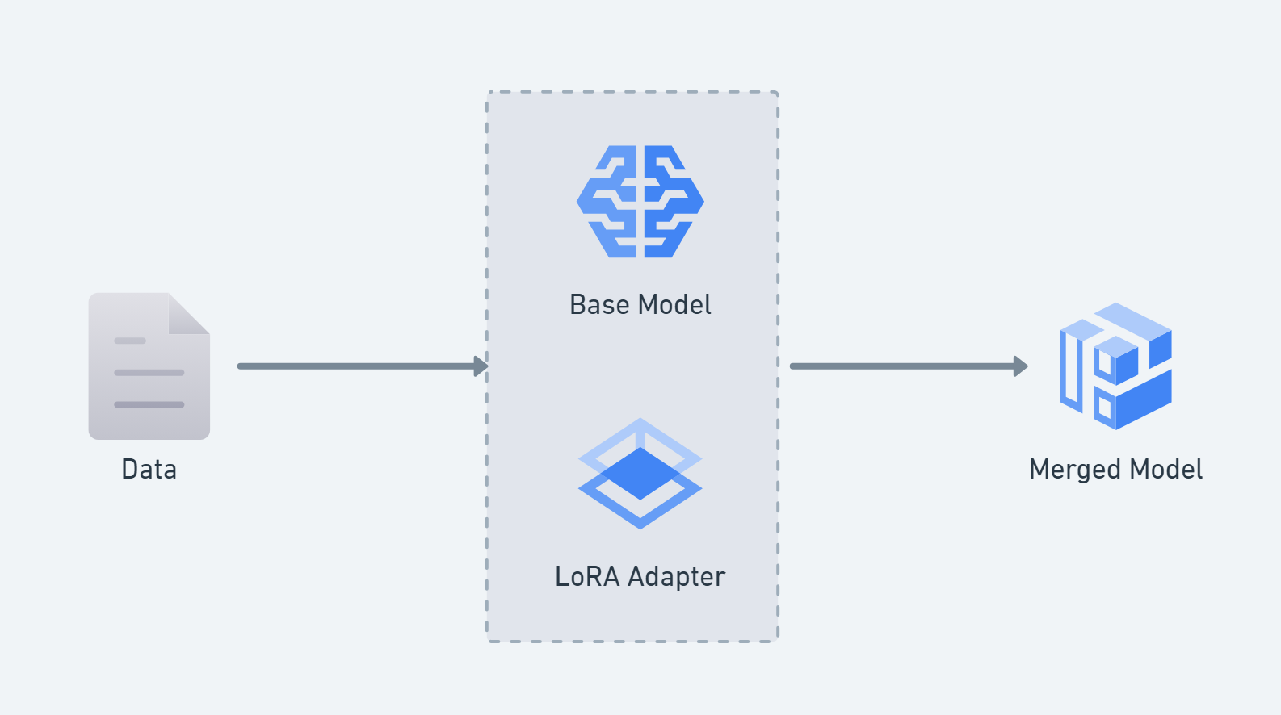
LoRA Adapters

Slide 11
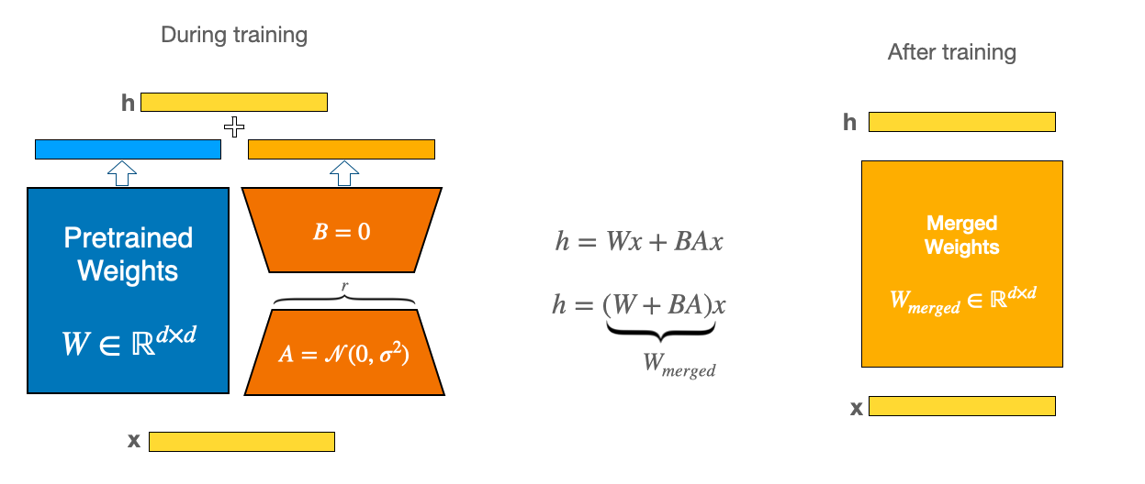
LoRA: Low-Rank Adaptation

Slide 12
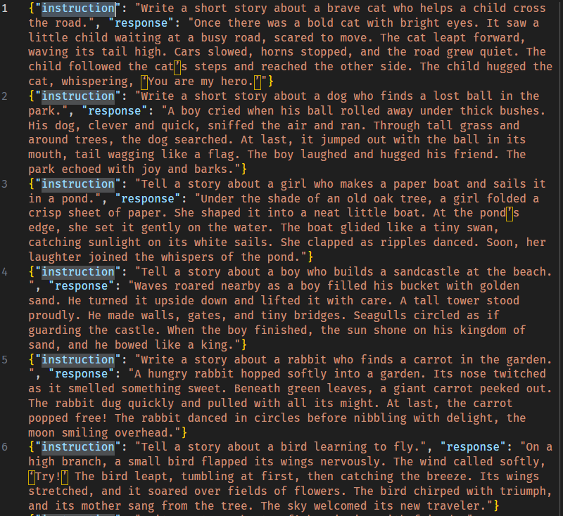
Dataset

Slide 13
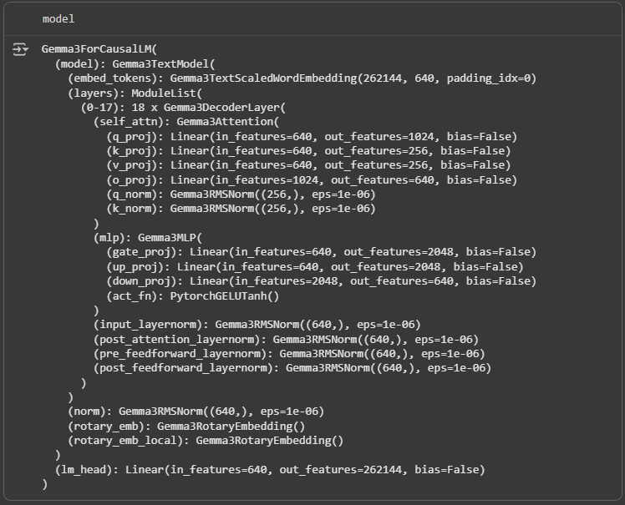
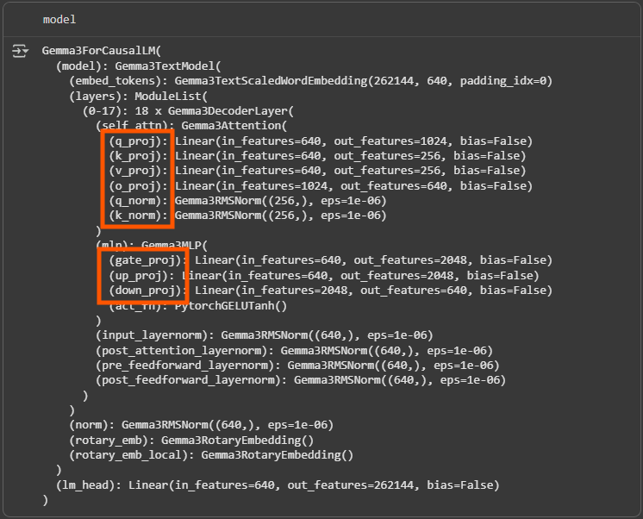
Base
Model

Slide 14
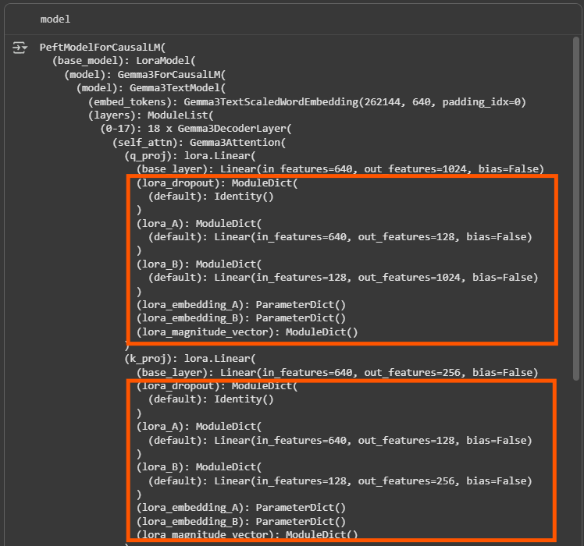
LoRA
Model
(PEFT)

Slide 15


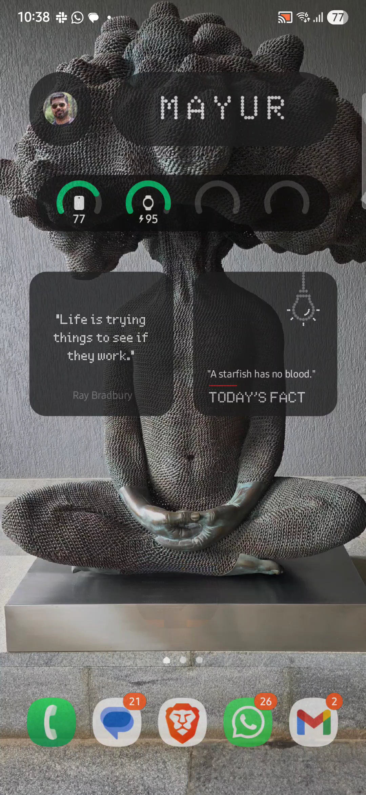



Slide 16
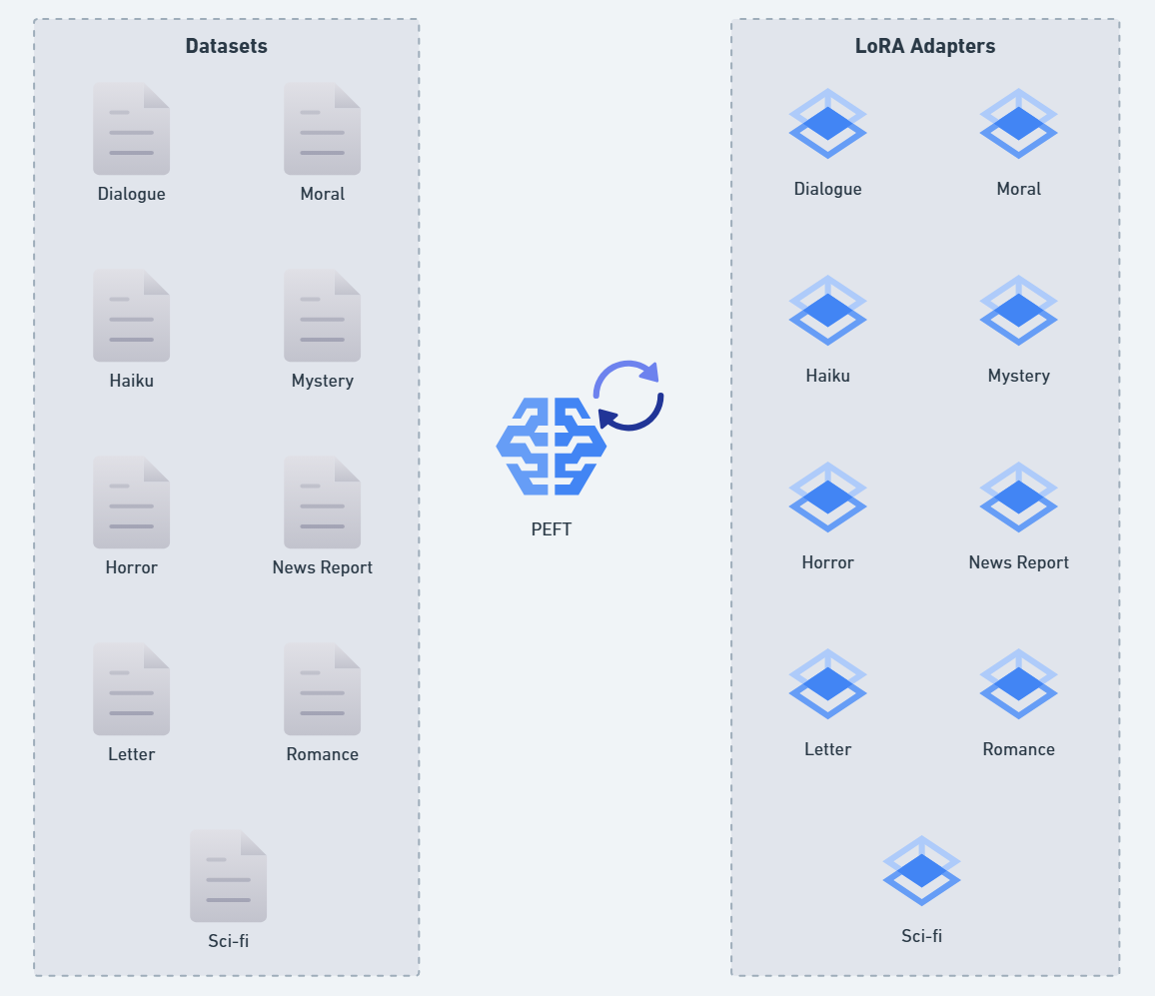
LoRA
Adapters

Slide 17
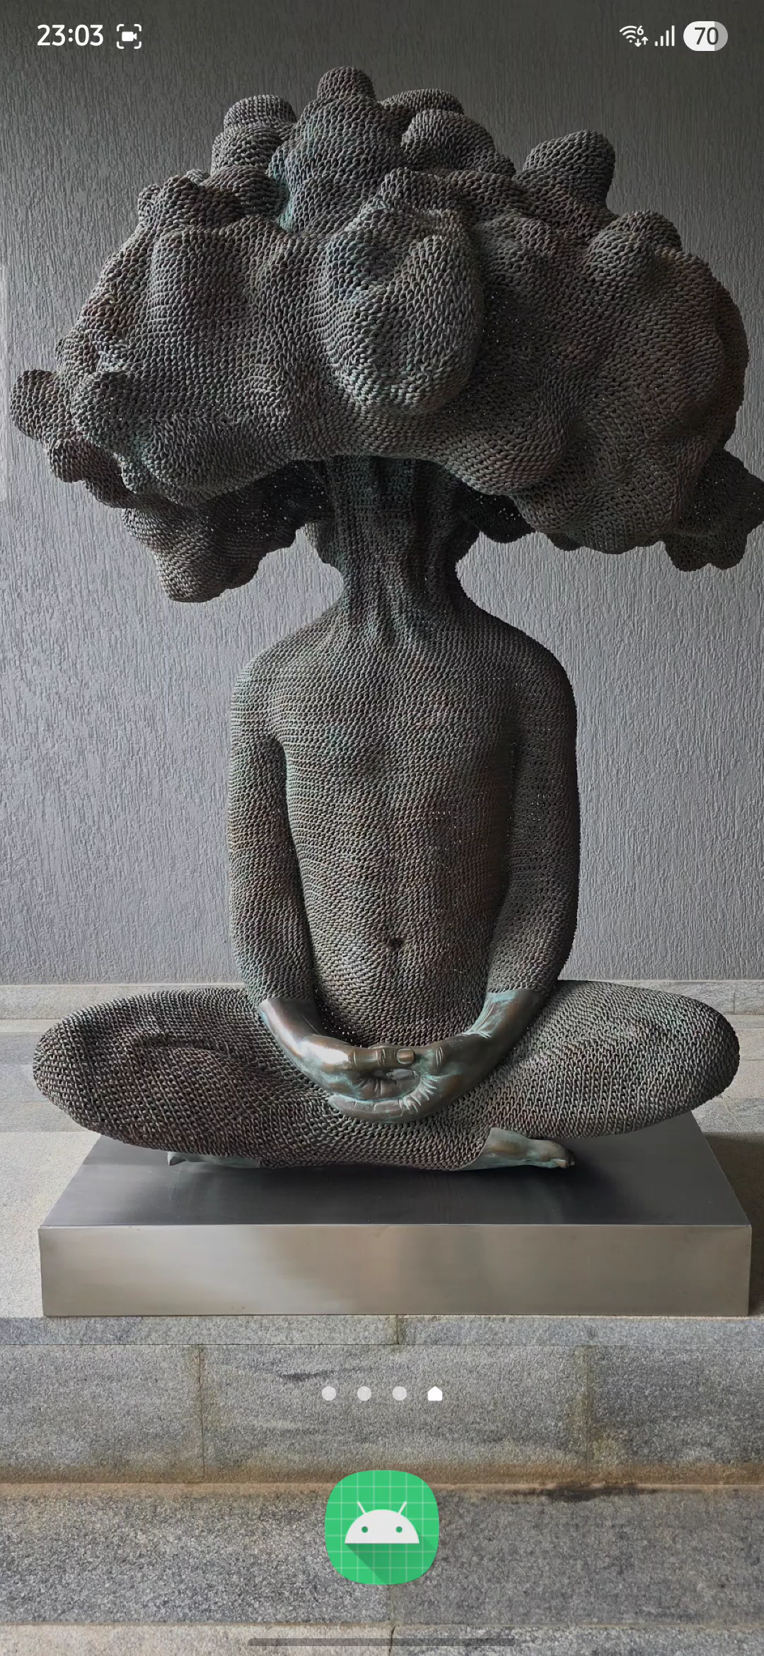

Adapter #1
Horror Micro Tales
Short scary stories

Slide 18

Adapter #2
Sci-Fi Flash Fiction
Future/space-themed micro stories

Slide 19

Adapter #3
Mystery Puzzles
Mini detective stories with a twist ending

Slide 20

Adapter #4
Romance Vignettes
Sweet romantic moments or meet-cutes

Slide 21

Adapter #5
Haiku Stories
Three-line poetic narratives

Slide 22
Adapter #6
Dialogue-Only Stories
Stories told entirely through conversation

Slide 23

Adapter #7
Letter/Diary Format
Epistolary micro-stories

Slide 24
Adapter #8
News Report Style
Stories written as news headlines/reports

Slide 25

Adapter #9
Moral Fables
Stories with explicit life lessons

Slide 26
Conclusion
SLM Advantage
Models like Gemma deliver lower deployment costs, faster inference, and practical industry benefits over LLMs.
Open-Source Foundation
Gemma provides efficient, Google-backed baselines for enterprise fine-tuning and specialized applications.
Balanced Adaptation
Techniques like prompt tuning and LoRA optimize the efficiency-effectiveness trade-off for resource-constrained deployments.

Slide 27


🌐linkedin.com/in/mayurmadnani
🌐github.com/mayurmadnani/MicroFables

